Slide 1



Unit- 2
Data Analytics with Python

Slide 2
Chapters for Discussion
Chapter - 1
Numerical Python - NumPy
Chapter - 2
Pandas (Data Manipulation and data analysis)

Slide 3

Chapter
Numerical Python - NumPy
1
Notes:
Dear Students, In today's session we are going to learn about Python.

Slide 4


DISCLAIMER
The content is curated from online/offline resources and used for educational purpose only.

Slide 5

Learning Objectives
Identify the purpose of Pandas for data manipulation with data frames and series.
Recognize NumPy as a library for handling arrays and numerical data.
Explain common techniques for handling missing values and preparing data for analysis.
GOAL
Source :
www.freepik.com/

Slide 6
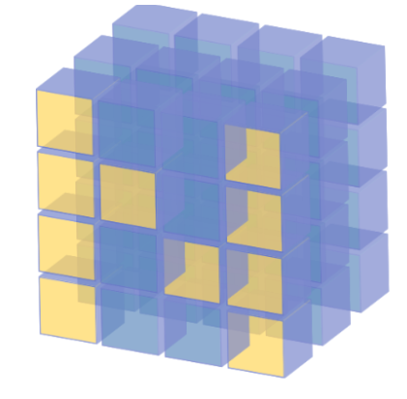
Introduction to NumPy
What is NumPy?
NumPy stands for Numerical Python.
It is a foundational package for numerical computing in Python.
Provides support for large multi-dimensional arrays and matrices.
Key Features:
Efficient handling of numerical data.
A wide array of mathematical functions to operate on these arrays.
Essential for scientific computing and data analysis.
Source :
https://www.scaler.com/topics/architecture-of-data-warehouse/
Notes:
What is NumPy?
NumPy, short for Numerical Python, is one of the core libraries in Python for numerical computing. It’s a foundational package in the data science ecosystem, widely used for performing efficient and fast computations on large datasets. NumPy is designed to handle multi-dimensional arrays and matrices efficiently, which makes it essential for data analysis, machine learning, and scientific computing.
Key Features of NumPy:
Efficient Handling of Numerical Data:
NumPy is optimized for operations on large arrays of data, which are stored in contiguous memory blocks. This setup allows for quick data access and computation, making NumPy much faster for numerical tasks compared to standard Python lists.
Support for Multi-dimensional Arrays:
The array is the central data structure in NumPy, and it can be one-dimensional (vectors), two-dimensional (matrices), or multi-dimensional (tensors). This versatility makes NumPy suitable for complex mathematical operations and multi-dimensional data manipulation.
Comprehensive Mathematical Functions:
NumPy provides a broad range of mathematical functions for array operations, including linear algebra, statistical functions, random sampling, and more. These functions make it easy to perform a wide array of calculations, from basic arithmetic to advanced linear algebra operations.
Essential for Scientific Computing and Data Analysis:
Due to its speed and efficiency, NumPy serves as the backbone of many other Python libraries for scientific computing and data analysis, such as Pandas, Matplotlib, and SciPy. Together, they form a powerful ecosystem for analyzing, visualizing, and working with large-scale data.

Slide 7
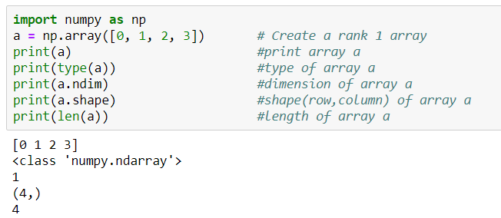
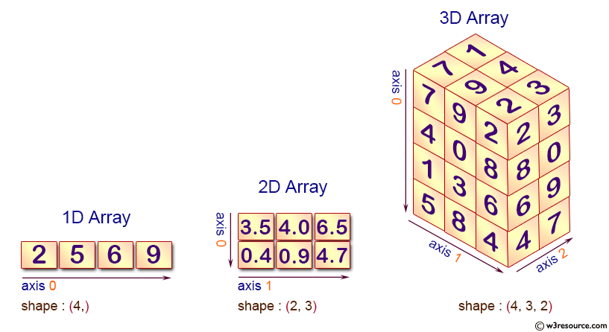
Numpy Array
NumPy array is a multi-dimensional data structure that is the core of scientific computing in Python.
All values in an array are homogenous (of the same data type).
They offer automatic vectorization and broadcasting.
Source :
https://medium.com/byte-sized-code/tagged/numpy
Notes:
NumPy Array
The NumPy array is a multi-dimensional data structure that serves as the foundation for scientific computing in Python. Arrays are the primary way of storing and manipulating numerical data in NumPy, and they are highly optimized for performance, making them essential in data analysis and machine learning.
Key Characteristics of NumPy Arrays:
Homogenous Data: All values within a NumPy array are homogenous, meaning they are of the same data type (e.g., all integers, all floats, etc.). This uniformity makes processing faster and more memory-efficient, as operations can be applied uniformly across all elements.
Multi-Dimensional Structure: Unlike traditional lists in Python, NumPy arrays can be multi-dimensional. This allows you to create arrays of any shape (1D vectors, 2D matrices, or higher-dimensional tensors), making them versatile and powerful for representing complex data structures, such as images or time-series data.
Automatic Vectorization and Broadcasting:
Vectorization: NumPy arrays support automatic vectorization, meaning you can perform mathematical operations on entire arrays without explicit loops. This leads to code that is not only faster but also more concise and readable.
Broadcasting: NumPy’s broadcasting feature enables operations on arrays of different shapes, which simplifies many mathematical operations. For example, you can add a scalar value to an array, or add two arrays of different shapes, without extra code.
Explanation of the code:
This code begins by importing the NumPy library as np, which is a popular library in Python for numerical computations.
It then creates a one-dimensional (rank 1) array a containing the integers 0 through 3.
The code proceeds to print the array a itself, displays its type (which will confirm it's a NumPy array), and checks the number of dimensions using a.ndim, which should return 1 for a one-dimensional array.
Additionally, it retrieves and prints the shape of the array with a.shape, which indicates the size of each dimension; since a is one-dimensional, this will return a tuple with a single value representing the length of the array.
Finally, it prints the length of the array using the built-in len() function, which confirms the number of elements in a, returning 4 in this case.

Slide 8
Working with Numpy array
Create 2-D array using numpy from list
import numpy as np
mylist=[[1,2,3],[4,5,6],[7,8,9]]
np.array(mylist)
Create 1-D and 2-D array using random values
np.random.rand(5) #uniform distribution of random values
np.random.rand(4,4) # create 2-D array of random values
np.random.randn(4) #std. normal distribution, centered around 0
Notes:
Creating a 2-D Array from a List:
The code first imports the NumPy library as np. It then defines a list called mylist, which is a nested list containing three sublists: [1, 2, 3], [4, 5, 6], and [7, 8, 9].
The np.array(mylist) function is used to convert this nested list into a 2-D NumPy array. This results in a 2-D array with three rows and three columns.
Creating Random Arrays:
np.random.rand(5): This function generates a 1-D array of 5 random values drawn from a uniform distribution between 0 and 1.
np.random.rand(4, 4): This generates a 2-D array with 4 rows and 4 columns, filled with random values from a uniform distribution between 0 and 1.
np.random.randn(4): This creates a 1-D array of 4 random values drawn from a standard normal distribution (mean 0 and standard deviation 1).

Slide 9
Commonly used Numpy methods & attributes
np.array(): Creates a NumPy array from a list or other iterable.
np.random.randint(0, 10, 1): Generates a random integer between 0 and 10, with size 1.
np.unique(): Finds the unique elements in an array and returns them in sorted order.
np.dot(): Computes the dot product of two arrays or matrices.
np.power(a, 2): Raises each element of array a to the power of 2.
np.sqrt(a): Returns the square root of each element in the array a.
np.ones(): Creates a new array of the specified shape, filled with ones.
np.zeros(): Creates a new array of the specified shape, filled with zeros.
np.max(): Returns the maximum value in the array.
np.arange(10): Creates an array with evenly spaced values from 0 to 9.
Notes:
Commonly Used NumPy Methods
NumPy provides a variety of methods that are essential for creating and manipulating arrays. Here are some of the most commonly used functions:
np.array():
This function creates a NumPy array from a list or any other iterable. It’s the fundamental method to convert standard Python data structures into NumPy arrays, enabling all the advantages of array operations.
Example: np.array([1, 2, 3]) creates a one-dimensional array with three elements.
np.random.randint(0, 10, 1):
Generates a random integer between 0 and 10, with the specified size. This method is useful for simulations and random sampling.
Example: np.random.randint(0, 10, 1) might produce an output like array([4]).
np.unique():
Finds the unique elements in an array and returns them in sorted order. This is particularly useful for data analysis when you want to identify distinct values.
Example: np.unique([1, 2, 2, 3]) would return array([1, 2, 3]).
np.dot():
Computes the dot product of two arrays or matrices. This is fundamental in linear algebra for various applications, including machine learning algorithms.
Example: np.dot(np.array([1, 2]), np.array([3, 4])) yields 11, which is calculated as 1∗3+2∗41*3 + 2*41∗3+2∗4.
np.power(a, 2):
Raises each element of the array a to the power of 2. This is a convenient way to apply element-wise operations on arrays.
Example: If a = np.array([1, 2, 3]), then np.power(a, 2) results in array([1, 4, 9]).
np.sqrt(a):
Returns the square root of each element in the array a. This is useful for statistical analysis and data transformation.
Example: For a = np.array([1, 4, 9]), np.sqrt(a) would return array([1., 2., 3.]).
np.ones():
Creates a new array of the specified shape, filled with ones. This can be useful for initializing matrices or tensors in computations.
Example: np.ones((2, 3)) creates a 2x3 array filled with ones.
np.zeros():
Similar to np.ones(), this method creates a new array of the specified shape, but filled with zeros. It’s often used to initialize arrays before populating them with data.
Example: np.zeros((2, 3)) generates a 2x3 array filled with zeros.
np.max():
Returns the maximum value in the array. This is helpful for identifying the largest element in datasets.
Example: For a = np.array([1, 5, 3]), np.max(a) would return 5.
np.arange(10):
Creates an array with evenly spaced values from 0 to 9. It’s similar to Python’s built-in range() function but returns a NumPy array instead.
Example: np.arange(10) results in array([0, 1, 2, 3, 4, 5, 6, 7, 8, 9]).

Slide 10
Applications of Numpy
Array Manipulation:
Creation, manipulation, and slicing of arrays.
Mathematical Operations:
Element-wise operations, linear algebra, statistical operations.
Integration with Other Libraries:
Works seamlessly with Pandas, SciPy, and Matplotlib.
Performance:
Optimized for speed, making it ideal for large-scale data analysis.
Notes:
Applications of NumPy
NumPy is an essential library for numerical computing in Python, with a wide range of applications in data analysis, scientific computing, and machine learning. Here are some key areas where NumPy shines:
Array Manipulation:
Creation: NumPy allows for the easy creation of arrays from lists, tuples, or even other arrays. This flexibility makes it straightforward to initialize data structures for various applications.
Manipulation: With NumPy, you can efficiently manipulate arrays by reshaping, merging, or splitting them, enabling complex data transformations.
Slicing: NumPy provides powerful slicing capabilities, allowing users to extract specific portions of arrays. This feature is crucial for data analysis tasks, where you often need to focus on particular subsets of your data.
Mathematical Operations:
Element-Wise Operations: NumPy enables element-wise operations on arrays, allowing you to perform calculations on entire datasets without explicit loops. This leads to cleaner and more efficient code.
Linear Algebra: NumPy provides comprehensive support for linear algebra operations, such as matrix multiplication, determinants, and eigenvalues, which are fundamental in various scientific and engineering applications.
Statistical Operations: The library includes a wide array of statistical functions (mean, median, standard deviation, etc.) that help analyze data distributions and trends, making it essential for data analysis tasks.
Integration with Other Libraries:
NumPy works seamlessly with other popular Python libraries, such as Pandas (for data manipulation), SciPy (for scientific computing), and Matplotlib (for data visualization). This integration enhances its functionality and allows users to leverage the strengths of each library in their data workflows.
Performance:
NumPy is optimized for speed and performance, making it ideal for large-scale data analysis. It uses efficient memory management and vectorized operations, enabling computations to be executed much faster than with traditional Python lists. This efficiency is crucial for handling big data and complex numerical tasks in fields like machine learning, statistics, and scientific research.

Slide 11

Lab Activity
Hands On
Lab 1
Create a NumPy array for energy consumption (in MWh) for different renewable source

Slide 12

Introduction to Pandas
What is Pandas?
Pandas is an open-source data manipulation and analysis library.
Built on top of NumPy.
Provides two main data structures: Series and DataFrame.
Series is a one dimensional array and DataFrame is two dimensional.
Key Features:
High-level data manipulation tools.
Data cleaning, transformation, and aggregation.
Merging and joining of datasets.
Source :
https://www.scaler.com/topics/architecture-of-data-warehouse/
Notes:
What is Pandas?
Pandas is an open-source library specifically designed for data manipulation and analysis, widely used in Python programming. It’s a powerful tool that enables data scientists and analysts to work efficiently with large datasets, offering an array of versatile tools for handling, cleaning, and analyzing data.
Foundation on NumPy: Pandas is built on top of another core library in Python, called NumPy, which provides support for large multi-dimensional arrays and matrices. NumPy helps with high-performance operations, and Pandas utilizes these features to enable fast, efficient data manipulation.
Key Data Structures:
Pandas provides two main data structures that allow us to work with data in different formats:
Series: A one-dimensional labeled array that can hold any data type (integers, strings, floats, etc.). Think of it as a single column in a spreadsheet or database.
DataFrame: A two-dimensional, size-mutable, and heterogeneous tabular data structure. You can think of it as a complete spreadsheet or table with labeled axes (rows and columns).
Key Features of Pandas:
High-level data manipulation tools: Pandas provides a set of powerful tools for reshaping, sorting, and filtering data, making it simpler to conduct data analysis.
Data Cleaning, Transformation, and Aggregation: With Pandas, you can handle missing data, perform calculations, modify data formats, and aggregate data to gain insights.
Merging and Joining Datasets: Pandas makes it easy to merge and join data from multiple sources, which is essential in real-world analysis where data may come from different files, databases, or APIs.

Slide 13
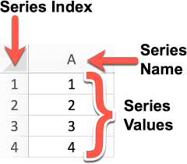
Pandas Series
Pandas Series is a labelled one-dimensional array that can hold any type of data (integer, string, float, Python objects, and so on).
Pandas Series is simply a column in an Excel spreadsheet.
Using the Series() method, we can easily convert a list, tuple, or dictionary into a Series.
Source :
https://codechalleng.es/bites/251/
Notes:
Pandas Series
A Pandas Series is a labeled one-dimensional array capable of holding any type of data, such as integers, strings, floats, or even complex Python objects. Think of a Pandas Series as being similar to a single column in an Excel spreadsheet—it provides both values and labels (or indexes) for each entry, making data organization simple and accessible.
Key Points about Pandas Series:
Versatile Data Types: A Series can contain different types of data within one column, making it flexible for various kinds of data analysis and manipulation.
Intuitive Labeling: Each entry in a Series has an associated index label. This indexing helps to quickly access, manipulate, and retrieve specific elements from the Series. Labels can be default numerical values (0, 1, 2, etc.) or custom labels as defined by the user.
Creating a Pandas Series with Series() Method:
The Series() method allows us to easily convert other data structures, like lists, tuples, or dictionaries, into a Series object:
From a list or tuple: The elements become values in the Series, with default numeric indexing.
From a dictionary: Keys of the dictionary become the index labels of the Series, while the values become the entries in the Series.

Slide 14
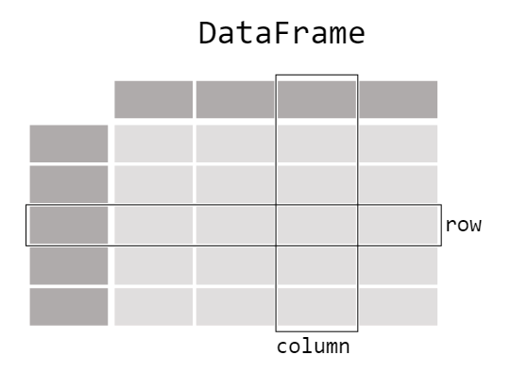
Pandas DataFrame
Panda has A two-dimensional data structure with corresponding labels is known as a dataframe.
Spreadsheets used in Excel or Calc or SQL tables are similar to DataFrames.
Pandas DataFrame consists of three main components: the data, the index, and the columns.
Source :
https://pandas.pydata.org/docs/getting_started/intro_tutorials/01_table_oriented.html
Notes:
Pandas DataFrame
A Pandas DataFrame is a core data structure in the Pandas library and one of the most versatile tools for handling data in Python. It’s a two-dimensional data structure with labeled rows and columns, making it similar to a table in a SQL database, an Excel spreadsheet, or a Google Sheet.
Key Characteristics of a DataFrame:
Two-Dimensional Format: DataFrames are structured with both rows and columns, allowing users to store and manipulate complex datasets in a structured way. Each row and column is labeled, enabling easy access to specific data points.
Intuitive Similarity to Common Data Formats: The structure of a DataFrame is similar to common data formats, like spreadsheets or SQL tables, making it easier to grasp for users already familiar with these tools.
Three Main Components of a DataFrame:
Data: The actual data stored in the DataFrame, which can include multiple data types—strings, integers, floats, or even more complex data types.
Index: The labels assigned to rows, which help uniquely identify each row. Indexing provides flexibility for quick data access and retrieval.
Columns: Each column has a unique label, allowing easy reference, filtering, and sorting by specific data points.
Creating and Working with DataFrames: DataFrames can be created from various sources, including lists of lists, dictionaries of lists, external CSV files, SQL databases, or even directly from other DataFrames. This adaptability makes DataFrames ideal for data analysis, exploration, and manipulation.

Slide 15
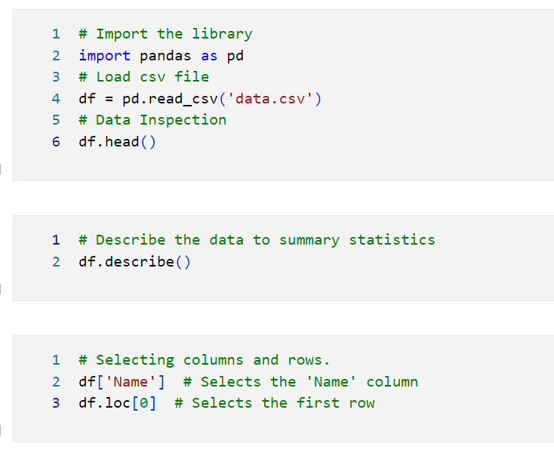
Basic Operations with Pandas
Loading Data: Read data from various formats (CSV, Excel, SQL).
Data Inspection: View the first few rows with head() and summary statistics with describe().
Data Selection: Selecting columns and rows.
Notes:
Basic Operations with Pandas
Pandas is a powerful data manipulation library in Python that provides a wide range of functions to work with structured data. Below are some basic operations you can perform using Pandas, including loading data, inspecting it, and selecting specific data subsets.
1. Loading Data
Pandas allows you to load data from various formats, making it easy to analyze and manipulate datasets. Here are some common methods:
Read CSV Files:
import pandas as pd
# Load a CSV file into a DataFrame
df = pd.read_csv('data.csv’)
Read Excel Files:
# Load an Excel file into a DataFrame
df = pd.read_excel('data.xlsx', sheet_name='Sheet1') # Specify sheet name if needed
Read SQL Databases:
from sqlalchemy import create_engine
# Create a database connection
engine = create_engine('sqlite:///database.db') # Example with SQLite
# Load data from a SQL query into a DataFrame
df = pd.read_sql_query('SELECT * FROM table_name', engine)
2. Data Inspection
Once you have loaded your data, it's essential to inspect it to understand its structure and contents.
View the First Few Rows:
# Display the first 5 rows of the DataFrame
print(df.head())
Summary Statistics:
# Get summary statistics for numerical columns
df.describe()
View DataFrame Information:
# Display information about the DataFrame, including data types and non-null counts
print(df.info())
3. Data Selection
Pandas makes it easy to select specific rows and columns from a DataFrame.
Selecting Columns:
# Select a single column
column_data = df['column_name’]
# Select multiple columns
subset_df = df[['column1', 'column2’]]
Selecting Rows:
# Select rows by index (e.g., first 10 rows)
first_ten_rows = df.iloc[:10]
# Select specific rows based on a condition
filtered_df = df[df['column_name'] > value] # Replace 'value' with your condition
Using .loc[] for Label-based Selection:
# Select rows and columns by labels
selected_data = df.loc[5:10, ['column1', 'column2']] # Rows 5 to 10 for specific columns
Using .iloc[] for Position-based Selection:
# Select rows and columns by index positions
selected_data = df.iloc[0:5, 0:2] # First 5 rows and first 2 columns

Slide 16
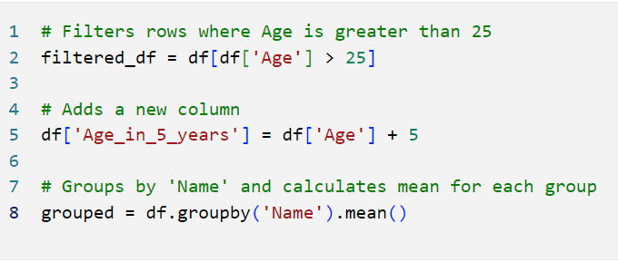
Data Manipulation Techniques
Filtering Data: Conditional selection of data.
Adding/Modifying Columns: Create new columns or modify existing ones.
Group By: Grouping data for aggregation.
Notes:
Data Manipulation Techniques in Pandas
Pandas provides a powerful set of tools for data manipulation, allowing users to filter, add or modify columns, and group data for aggregation. Here’s a closer look at these techniques:
1. Filtering Data
Filtering is a crucial technique used to select subsets of data based on specific conditions.
Conditional Selection: You can filter DataFrames using boolean indexing to retrieve rows that meet certain criteria.
import pandas as pd
# Example DataFrame
data = { 'Name': ['Alice', 'Bob', 'Charlie', 'David'], 'Age': [24, 30, 22, 35], 'Salary': [50000, 60000, 52000, 58000] }
df = pd.DataFrame(data)
# Filter rows where Age is greater than 25
filtered_df = df[df['Age'] > 25]
print(filtered_df)
Multiple Conditions: You can also combine multiple conditions using logical operators (& for AND, | for OR).
# Filter rows where Age is greater than 25 and Salary is less than 60000
filtered_df = df[(df['Age'] > 25) & (df['Salary'] < 60000)]
print(filtered_df)
2. Adding/Modifying Columns
Pandas allows you to create new columns or modify existing ones easily.
Adding a New Column: You can create a new column by assigning values based on existing columns.
# Add a new column 'Tax' which is 10% of Salary
df['Tax'] = df['Salary'] * 0.10
print(df)
Modifying an Existing Column: You can update values in an existing column by performing operations on it.
# Increase the Salary by 5%
df['Salary'] = df['Salary'] * 1.05
print(df)
Using apply() to Modify Columns: The apply() function allows you to apply a function to a DataFrame column.
# Define a function to categorize ages
def categorize_age(age):
if age < 30:
return 'Young’
else:
return 'Old’
# Apply the function to create a new column 'Age Group’
df['Age Group'] = df['Age'].apply(categorize_age)
print(df)
3. Group By
Grouping data is essential for aggregation and summary statistics.
Group By for Aggregation: The groupby() method allows you to group data by one or more columns and then apply aggregation functions like sum(), mean(), count(), etc.
# Group by 'Age Group' and calculate the average Salary
group_df = df.groupby('Age Group')['Salary'].mean().reset_index()
print(group_df)
Multiple Aggregations: You can perform multiple aggregation operations using the agg() method.
# Group by 'Age Group' and get multiple statistics
agg_df = df.groupby('Age Group').agg({ 'Salary': ['mean', 'max', 'min'], 'Age': 'count' }).reset_index()
print(agg_df)

Slide 17
Pandas Applications
Data Handling:
Importing data from various file formats (CSV, Excel, SQL databases).
Handling missing data.
Data Wrangling:
Filtering, grouping, merging, and reshaping data.
Exploratory Data Analysis:
Descriptive statistics and data visualization support.
Notes:
Applications of Pandas
Pandas is an essential library for data science and analytics, with applications that span several key areas. Here’s a breakdown of its primary uses:
Data Handling:
Importing Data: Pandas can import data from various sources and formats, including CSV files, Excel spreadsheets, SQL databases, and even JSON files. This versatility simplifies working with data from different systems and makes it easy to integrate data sources for analysis.
Handling Missing Data: In real-world data, missing values are common. Pandas provides tools to identify, fill, replace, or drop missing data, making it easier to clean datasets and prepare them for analysis.
Data Wrangling:
Filtering and Grouping: Pandas offers intuitive ways to filter data based on conditions, and group data by specific columns to obtain insights from different segments within a dataset.
Merging and Joining: You can merge or join multiple datasets based on shared keys or indexes, which is valuable when working with related data from multiple sources.
Reshaping Data: Pandas allows data reshaping through pivoting, stacking, and unstacking, which helps to reorganize data to fit analysis needs better.
Exploratory Data Analysis (EDA):
Descriptive Statistics: Pandas provides quick access to summary statistics like mean, median, min, max, and standard deviation, which helps understand data distributions and identify outliers.
Data Visualization Support: Though Pandas isn’t a dedicated visualization library, it integrates with Matplotlib and Seaborn for visualizing data, enabling quick, simple charts directly from DataFrames to visualize trends and patterns in the data.

Slide 18
What is Data Preprocessing?
Data preprocessing is the essential process of transforming raw data into a clean, organized, and usable format suitable for analysis.
It involves cleaning, structuring, and transforming data to ensure data quality and consistency.
The Data Preprocessing Process:
Data preprocessing typically involves four key steps:
Discovery: Understanding the data, identifying its structure, format, and potential issues.
Transformation: Converting data into a suitable format for analysis, including handling missing values, outliers, and inconsistencies.
Validation: Ensuring data accuracy and consistency through checks and verification.
Publishing: Preparing the processed data for analysis and consumption.
Notes:
Data Preprocessing
Data preprocessing is a crucial process that transforms raw data into a clean, organized, and usable format that is suitable for analysis. It lays the foundation for effective data analysis by ensuring that the data is accurate, consistent, and ready for the next steps in any analytical workflow.
Data preprocessing involves several essential tasks that enhance data quality and ensure consistency. Properly preprocessed data improves the reliability of analysis, leading to more accurate insights and better decision-making.
Data preprocessing typically involves four key steps:
Discovery: Understanding the data, identifying its structure, format, and potential issues.
Transformation: Converting data into a suitable format for analysis, including handling missing values, outliers, and inconsistencies.
Validation: Ensuring data accuracy and consistency through checks and verification.
Publishing: Preparing the processed data for analysis and consumption.

Slide 19
Discovery and Transformation Phase
Discovery Phase
Goal: Understand data in context of the use case.
Activities: Clean, structure, organize, and map data.
Outcome: Determine the best approach for data preprocessing.
Transformation Phase
Primary Activities:
Structuring: Organizing data into a specific format.
Normalizing: Adjusting data values to a common scale.
De-normalizing: Converting normalized data into its original format.
Cleaning: Removing or correcting errors.
Enriching: Adding additional information to data.
Notes:
Discovery Phase
The primary goal of the Discovery Phase is to understand the data in the context of the specific use case. This involves gaining insights into the data's characteristics, structure, and potential challenges that might affect analysis.
Activities:
Clean: Identify and address initial data quality issues, such as missing values or outliers that could impact the analysis.
Structure: Determine how the data is organized and whether it is in a suitable format for analysis. This may involve assessing whether the data is in tabular form, time-series format, etc.
Organize: Arrange the data logically to facilitate further processing. This might include categorizing variables or defining the relationships between different datasets.
Map Data: Create a data dictionary or schema that outlines the data types, variable definitions, and relationships among different datasets. This helps clarify how each piece of data contributes to the analysis.
Outcome: The outcome of the Discovery Phase is to determine the best approach for data preprocessing. By thoroughly understanding the data, you can make informed decisions about the methods and techniques that will be most effective for transforming the data into a usable format for analysis.
Transformation Phase
The Transformation Phase focuses on preparing the data for analysis through various techniques.
Key activities include:
Structuring:
Organizing data into a specific format suitable for analysis, such as converting data into tabular formats or creating structured datasets from unstructured sources.
Example: Transforming raw text data into a structured table with columns for different attributes.
Normalizing:
Adjusting data values to a common scale to ensure that no particular feature disproportionately affects the results. This is essential in algorithms sensitive to the scale of input data.
Example: Scaling numerical features to a range between 0 and 1, or standardizing them to have a mean of 0 and a standard deviation of 1.
De-normalizing:
Converting normalized data back into its original format or scale, if needed, to interpret results in a more understandable context.
Example: Converting scaled values back to their original units for reporting or presentation purposes.
Cleaning:
Removing or correcting errors in the data, such as inconsistencies, duplicates, or incorrect values. This is crucial for ensuring the integrity and reliability of the dataset.
Example: Identifying and correcting typos in categorical variables or removing duplicate records.
Enriching:
Adding additional information to the data to provide more context or enhance the analysis. This could involve merging datasets, adding new features, or integrating external data sources.
Example: Combining customer data with demographic information to enrich insights for a marketing analysis.

Slide 20
Validation and Publishing Phase
Validation Phase
Purpose: Evaluate data quality post-transformation.
Validation Rules: Repetitive programming procedures to ensure data accuracy, reliability, and security.
Publishing Phase
Definition: Delivering the processed data for use in projects.
Includes: Transformed and validated data, and metadata.
Notes:
Validation Phase
The Validation Phase is critical for evaluating the quality of data after transformation. This step ensures that the data meets specific standards of accuracy, reliability, and security, making it fit for analysis and decision-making.
Validation Rules:
During this phase, a set of validation rules is applied. These are repetitive programming procedures designed to verify the integrity of the data. Key aspects include:
Accuracy: Ensuring that the data correctly represents the real-world scenarios it is supposed to depict. This may involve cross-checking against known values or validating calculations.
Reliability: Confirming that the data remains consistent and trustworthy across different analyses or datasets. This might include checks for data consistency over time.
Security: Ensuring that sensitive data is handled appropriately, adhering to privacy standards and regulations. This includes checking for unauthorized access and validating that data is stored securely.
Common Validation Techniques:
Automated Scripts: Utilizing scripts to run checks on data quality metrics, such as completeness, validity, and uniqueness.
Statistical Checks: Applying statistical methods to validate distributions and ranges of numerical data.
Peer Review: Involving team members in reviewing the data and the validation processes to catch potential issues that automated methods may miss.
Publishing Phase
The Publishing Phase involves the final delivery of the processed data for use in projects. This step is crucial for making the data accessible and usable for analysis and decision-making by stakeholders.
Includes:
Transformed and Validated Data:
The core output of this phase is the cleaned and processed dataset, which has undergone the entire preprocessing pipeline, ensuring its quality and reliability.
This data is structured and ready for analysis, typically stored in formats such as CSV, JSON, or in databases.
Metadata:
Along with the dataset, accompanying metadata is provided. Metadata includes important information about the data, such as:
Data Source: Where the data was originally collected or obtained.
Transformation Steps: A summary of the preprocessing steps taken, which is crucial for transparency and reproducibility.
Data Dictionary: Definitions of each variable, including types and units of measurement, which helps users understand the data better.
The Publishing Phase ensures that the processed data is delivered in a way that is both usable and understandable, enabling effective utilization in analysis, reporting, and decision-making processes.

Slide 21
Data Preprocessing Techniques - Data Cleaning
Goal: Handle incorrect, incomplete, inconsistent, or missing values.
Techniques:
Handling Missing Values:
Removing rows/columns with NULL values.
Imputing missing values using mean, mode, regression, etc.
De-noising:
Removing noise from data (e.g., entry errors, faulty collection).
Techniques: Binning, regression smoothing, clustering.
Notes:
Data Preprocessing Techniques - Data Cleaning
The primary goal of Data Cleaning is to handle incorrect, incomplete, inconsistent, or missing values in the dataset. Data cleaning is a critical step in the preprocessing phase because the quality of data directly impacts the accuracy and reliability of the analysis. Proper data cleaning helps ensure that the insights derived from the data are valid and actionable.
Techniques for Data Cleaning
Handling Missing Values:
Removing Rows/Columns:
One straightforward approach is to remove rows or columns that contain NULL or missing values. This is useful when the amount of missing data is minimal and won’t significantly impact the overall dataset.
Example: If a column has more than 50% missing values, it may be more practical to remove the entire column rather than trying to fill in those gaps.
Imputing Missing Values:
When it’s not feasible to remove missing data, imputation techniques can be employed to fill in the gaps. Common methods include:
Mean Imputation: Replacing missing values with the mean of the available data for that variable. This method is straightforward but can distort the original data distribution.
Mode Imputation: Using the mode (most frequent value) for categorical variables to fill in missing entries.
Regression Imputation: Predicting missing values based on other variables in the dataset using regression techniques. This approach can be more accurate, especially when dealing with complex datasets.
K-Nearest Neighbors (KNN): Utilizing the KNN algorithm to find the nearest observations and using their values to impute the missing data. This method considers the relationships between different data points.
De-noising:
Removing Noise: Data often contains noise, which refers to random errors or fluctuations that can obscure the underlying trends in the data. Common sources of noise include entry errors, faulty data collection methods, or sensor inaccuracies.
Techniques for De-noising:
Binning: This technique involves grouping continuous data into discrete intervals or "bins." By aggregating values into bins, you can reduce the impact of noise and highlight trends. For example, instead of analyzing individual temperatures, you could analyze temperature ranges (e.g., 0-10°C, 11-20°C).
Regression Smoothing: This approach uses regression analysis to fit a smooth curve to the data, effectively filtering out noise while preserving the main trends. Techniques like polynomial regression can be useful here.
Clustering: Clustering algorithms can identify and group similar data points, allowing you to detect and potentially remove outliers or erroneous entries that do not fit within any cluster. For instance, K-means clustering can help identify natural groupings in the data, making it easier to spot anomalies.

Slide 22
Data Preprocessing Techniques - Data Reduction
Purpose: Reduce data volume for storage and analysis efficiency.
Techniques:
Dimensionality Reduction:
Reduce number of features.
Methods: Feature selection, PCA.
Numerosity Reduction:
Use smaller data representations (e.g., regression models).
Data Compression:
Compress data (lossless or lossy).
Notes:
Data Preprocessing Techniques - Data Reduction
The primary purpose of Data Reduction is to reduce the volume of data while maintaining its integrity and meaning. This process enhances storage efficiency and improves the speed and performance of data analysis. By minimizing data complexity, analysts can focus on the most relevant information, leading to faster and more insightful analyses.
Techniques for Data Reduction
Dimensionality Reduction:
Goal: To reduce the number of features (dimensions) in a dataset while retaining the most important information. High-dimensional data can be challenging to analyze due to the "curse of dimensionality," which can lead to overfitting and increased computational costs.
Methods:
Feature Selection: This involves identifying and retaining only the most relevant features of the dataset while removing those that contribute little or no information. Techniques such as correlation analysis, recursive feature elimination, or using machine learning algorithms (like decision trees) can help in selecting significant features.
Principal Component Analysis (PCA): PCA is a mathematical technique that transforms the data into a new set of dimensions (principal components) that capture the maximum variance. This method reduces dimensionality by projecting the data onto fewer dimensions while preserving as much variance as possible. It’s widely used in exploratory data analysis and for visualizing high-dimensional datasets.
Numerosity Reduction:
Goal: To create smaller, more manageable data representations while retaining essential characteristics of the original data.
Methods:
Regression Models: Utilizing regression techniques to summarize and represent relationships within the data can significantly reduce the data volume. Instead of working with raw data points, you can analyze the coefficients and predictions from regression models, effectively condensing the information.
Data Aggregation: This technique involves summarizing data by combining multiple records into single data points. For example, instead of storing individual sales transactions, you could store total sales by month or category.
Data Compression:
Goal: To reduce the size of data files to save storage space and improve transmission speeds.
Methods:
Lossless Compression: This method compresses data without any loss of information, allowing the original data to be perfectly reconstructed. Common lossless compression algorithms include ZIP and PNG for images. This is crucial when data integrity is paramount.
Lossy Compression: In contrast, lossy compression reduces file size by removing less critical information, which can result in a loss of quality. This method is commonly used for media files, such as JPEG for images and MP3 for audio, where a slight loss of quality is acceptable in exchange for significantly reduced file sizes.

Slide 23
Data Preprocessing Techniques - Data Transformation
Goal: Convert data into a format for efficient ML models and insights.
Methods:
Smoothing: Remove noise, identify patterns.
Aggregation: Summarize large data volumes.
Discretization: Convert continuous variables into intervals/bins.
Normalization: Adjust numeric variables to a specified range.
Notes:
Data Preprocessing Techniques - Data Transformation
The primary goal of Data Transformation is to convert data into a format that is suitable for efficient machine learning (ML) modeling and insightful analysis. Transforming data helps enhance its quality and makes it more compatible with various algorithms, ultimately improving the performance of predictive models.
Methods for Data Transformation
Smoothing:
Purpose: To remove noise from the data and identify underlying patterns. Noise can obscure the true signals in the data, making it difficult to derive meaningful insights or train accurate models.
Techniques:
Moving Averages: A technique that smooths data by averaging a fixed number of preceding values. This method is often used in time series analysis to identify trends over time.
Exponential Smoothing: A more sophisticated smoothing technique that applies decreasing weights to older observations, making recent data more influential in the analysis.
Kernel Smoothing: This technique uses a kernel function to weigh nearby data points differently, allowing for flexible smoothing that can adapt to the underlying data structure.
Aggregation:
Purpose: To summarize large volumes of data into more manageable and insightful formats. Aggregation helps in reducing data complexity and facilitating analysis by focusing on key metrics.
Techniques:
Group By Operations: Summarizing data by grouping it based on one or more keys (e.g., summing sales data by product category or calculating averages by region).
Statistical Aggregation: Calculating metrics such as mean, median, mode, and standard deviation to summarize data distributions. This helps in understanding central tendencies and variability within datasets.
Discretization:
Purpose: To convert continuous variables into discrete intervals or bins. This process can help in simplifying the analysis and making data more interpretable, especially for algorithms that perform better with categorical inputs.
Techniques:
Equal Width Binning: Dividing the range of continuous data into intervals of equal size. This method is straightforward but may lead to bins with varying numbers of observations.
Equal Frequency Binning: Creating bins so that each bin contains approximately the same number of data points. This method helps in maintaining a balanced representation across intervals.
Clustering-based Discretization: Using clustering algorithms to determine the best boundaries for bins based on the distribution of data points.
Normalization:
Purpose: To adjust numeric variables to a specified range, typically between 0 and 1 or -1 and 1. Normalization is crucial when features have different scales, as many machine learning algorithms assume data is centered around zero or has comparable ranges.

Slide 24
Lab Activity
Hands On
Lab 2
Series, DataFrames, and Basic Operations

Slide 25

Conclusion
This overview provides a structured approach to learning Python.
Core elements covered include Python's features, installation, data types, control structures, and programming constructs.
The learning journey starts with basics (variables, data types, control structures).
It progresses to advanced topics like functions, classes, inheritance, and encapsulation.
Libraries like Pandas, NumPy, Matplotlib, and Seaborn are introduced for data manipulation and visualization.
Mastering these concepts and tools builds a solid foundation for using Python in programming and data-driven applications.
Source :
www.freepik.com/

Slide 26
References
https://www.javatpoint.com/python-features
https://www.geeksforgeeks.org/python-language-advantages-applications/
https://docs.anaconda.com/anaconda/install/index.html
https://www.w3schools.com/python/python_datatypes.asp
https://realpython.com/python-conditional-statements/
https://www.w3schools.com/python/python_classes.asp
https://www.geeksforgeeks.org/inheritance-in-python/
https://pandas.pydata.org/docs/getting_started/intro_tutorials/index.html
https://numpy.org/doc/stable/user/quickstart.html
https://towardsdatascience.com/data-cleaning-with-pandas-bd8e8b6a7c9a
https://matplotlib.org/stable/tutorials/introductory/pyplot.html

Slide 27


Let’s Start

Slide 28


Quiz
How do you copy a NumPy array to ensure changes to the copy don't affect the original?
(a) array.copy()
(b) np.array(array)
(c) np.arraycopy(array)
(d) Assigning the array to a new variable creates a copy
Answer: A
array.copy()

Slide 29
Quiz
2. How do you concatenate two 2D NumPy arrays vertically?
np.vstack((arr1, arr2))
np.concatenate((arr1, arr2))
np.hstack((arr1, arr2))
np.row_stack((arr1, arr2))
Answer: A
np.vstack((arr1, arr2))

Slide 30
Quiz
3. How do you select rows from a DataFrame df where a specific column 'column_name' contains a certain value 'value’?
df[df['column_name'] == 'value’]
df.select_rows('column_name' == 'value’)
(c) df.filter('column_name' == 'value’)
(d) df.filter('column_name', 'value')
Answer: A
df[df['column_name'] == 'value’]

Slide 31
Thank You
Notes:
Thank You !!

